Slide 1

by Innoaesthetics
Speaker
Víctor García Guevara MD

Slide 2
Intimate Pigmentation

Slide 3
Gynecologic Hyper-Pigmentation
Solar radiation.
Skin aggresion: shaving, depilation, protective towels, underwear, toilet paper, etc.
Hormonal factor.
Intrinsic skin aging.
Menstruation.

Slide 4
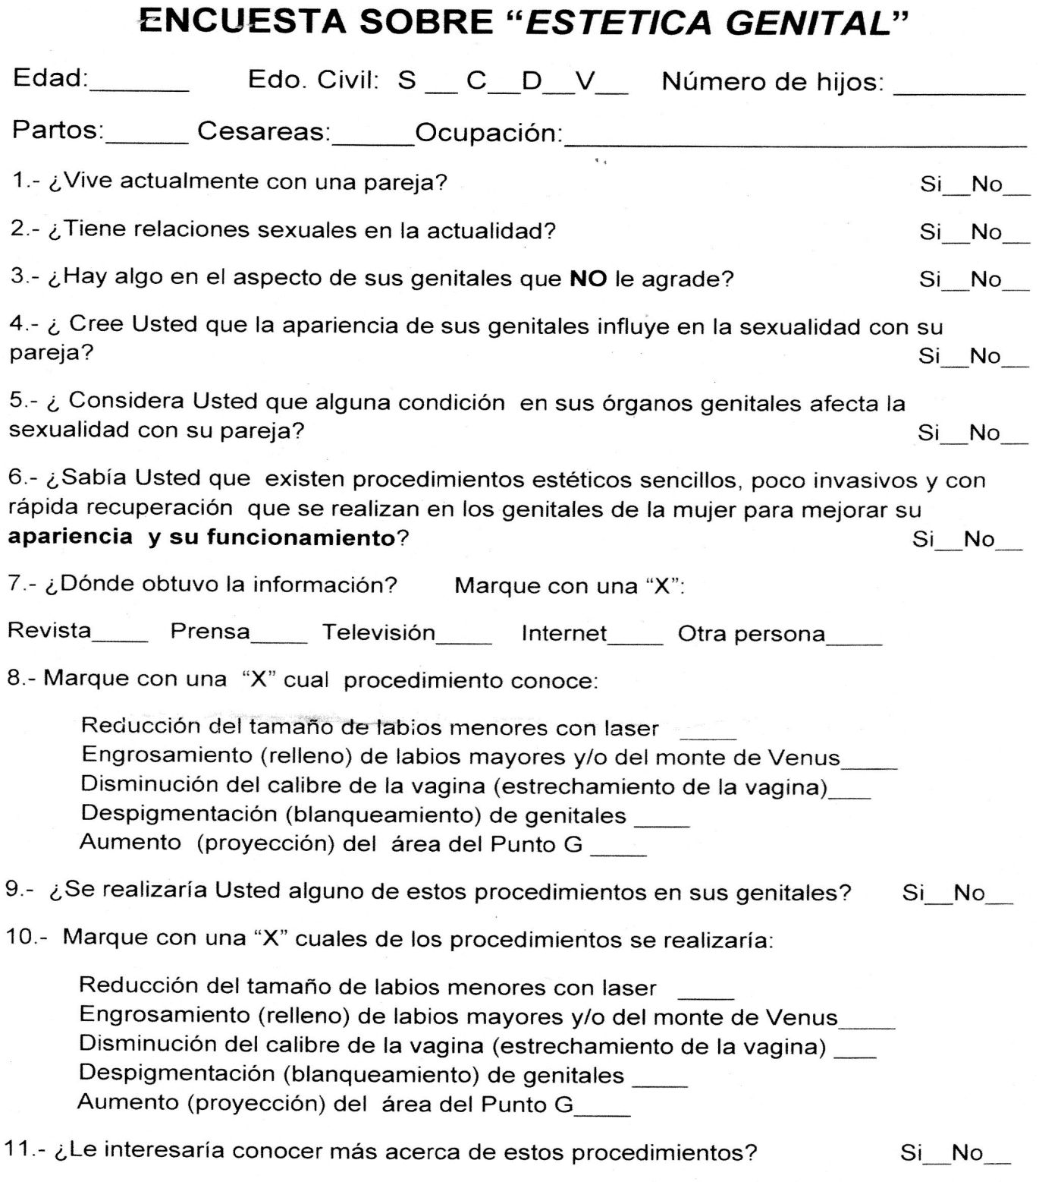

Slide 5
Is there something about the appearance of your genitals that you do not like?
Yes: 29.82%. 68/228 respondents
Do you believe that the appearance of your genitals influences sexuality with your partner?
Yes: 27.63%. 63/228 respondents
Do you consider that any condition on your genitals affects sexuality with your partner?
Yes: 20.17%. 46/228 respondents
Did you know that there are simple, non-invasive and quick-recovery aesthetic procedures performed on women's genitals to improve their appearance and functioning?
Yes: 65.78%. 150/228 respondents
Would you do any of these procedures?
Yes: 49.12% 112/228 respondents

Slide 6
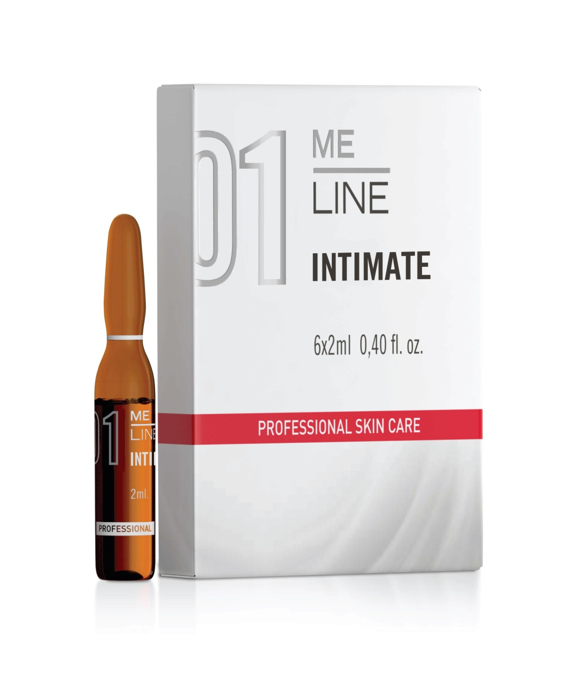
ME LINE 01: INTIMATE
Professional products
ACTIVE INGREDIENTS | % | Action
Mandelic Acid | 20 | Promotes exfoliation of the stratum corneum. Disperses the melanin in the basal layer of the epidermis.
Tranexamic Acid | 5 | Inhibition of plasminogen and inactivation of Tyrosinase.
Lactobionic Acid | 15 | Prevents the formation of free radicals and inhibits the activity of metalloproteinases. It increases the power of the skin barrier protection.
Salicylic Acid | 2 | Keratolytic. It causes epidermal desquamation by rupture of intercellular bridges (desmosomes)
Retinal | 1 | Induces epidermal desquamation, increasing epidermal renewal. Inhibits transcription factor Tyrosinase, and interfere with the transfer of melanosomes to keratinocytes.

Slide 7
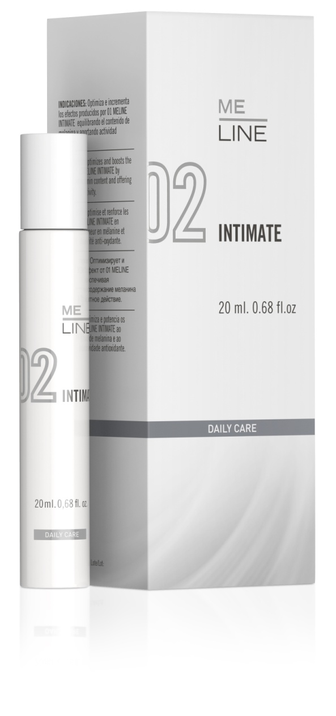
ME LINE 02 INTIMATE
ACTIVE INGREDIENTS NIGHT | % | Action
Tranexamic Ac | 15 | Inhibits the melanin synthesis
Ascorbic Acid | 4 | Reduction of oxidized melanin.
Arbutin | 4 | Inhibits polymerase activity and melanosome maturation.
Melanostatine-5 | 5 | Prevents binding to its receptor Melanotropin. Inhibition of the RNAm
Niacinamide | 5 | Inhibition of the passage of melanosomes
Lactobionic Ac. | 3 | Inhibition of melanin production Melanotropin activity
Phityc Acid | 2 | Chelating effect. Neutralization of free radicals
Kojic Acid | 2 | Promotes exfoliation of the stratum corneum. Disperses the melanin in the basal layer the epidermis
Retinal | 0.1 | Induces epidermal desquamation, increasing epidermal renewal. Inhibits transcription factor RNAm Tyrosinase, and interferes in the transfer of melanosomes to keratinocytes.

Slide 8
Evaluation of a therapeutic protocol for the treatment of pigmentation in the intima.
Gaviria Jorge MD 1, Lemmo Andrés 2, Martinez Darling 3 García Guevara Víctor 4.
1 Gynecologist of the Hospital Domingo Luciani.
2 Head of the Gynecology Service of the University Hospital of Caracas.
3 Gynecologist of the University Hospital of Caracas.
4 Medical Advisor Laboratorios Innoaesthetics
Sample: 65 patients in total
35 patients Consultation of Gynecology of the University Hospital of Caracas.
30 patients Consultation of Gynecology Hospital Domingo Luciani, Caracas
Working Protocol:
Treatment with MeLine 01 Intimate every 15 days for 3 sessions.
Treatment with MeLine 02 Intimate for 180 days.

Slide 13
THANK YOU

